Slide 1
Genetics
Biology 6(F)

Slide 2
Using Punnett Squares
Learning Objectives
Understand basic genetics vocabulary
Predict outcomes of monohybrid crosses
Predict outcomes of dihybrid crosses
B
b
B
BB
Bb
b
Bb
bb
Notes:
After this lesson, you will feel comfortable with basic genetic vocabulary. You will also be able to predict outcomes of monohybrid and dihybrid crosses by using Punnett squares, pictured below.

Slide 3
What is Genetics?
Why do people look different from one another?
Different DNA (genetic material)
Different proteins
(appearances)
Notes:
Why are there different hair colors? What decides what color eyes children have? Organisms look different from one another because they have different DNA, their genetic material. Different genes code for different proteins, resulting in different appearances.

Slide 4
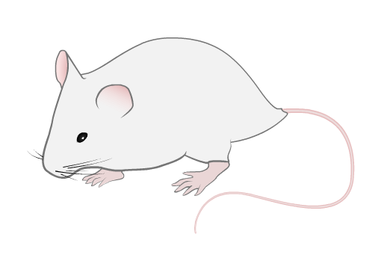
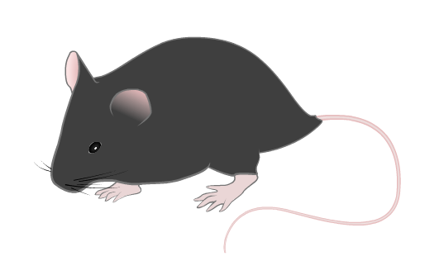
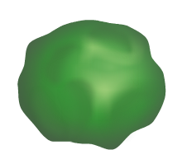
Genetics Vocabulary
Character
a recognizable feature controlled by genetics
Trait
a version of a character
fur color
seed shape
white fur
wrinkled seeds
Notes:
In genetics, the feature you are looking at is called a character. Characters can be almost anything such as fur color in mice or seed shape in pea plants.
These characters come in different versions, which are called traits.
For example, fur color has the trait white fur. Seed shape has the trait wrinkled seeds.

Slide 5
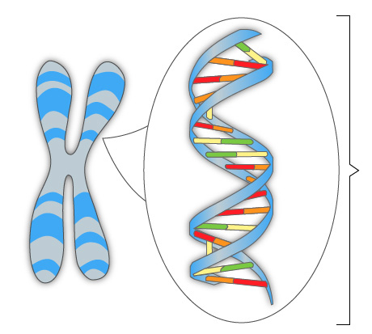
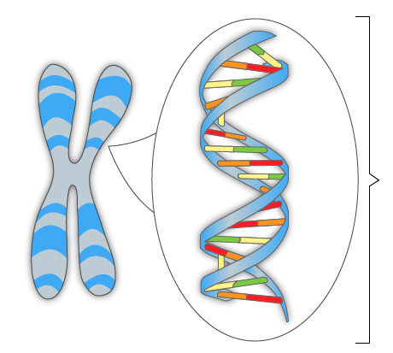
Genetics Vocabulary
Allele
the section of DNA that codes for a specific trait
B
b
Notes:
The sections of DNA that code for a trait are called alleles. People with different traits for a character have different sections of DNA. Alleles are usually written as single letters. The capitalization depends on which trait the allele codes for.

Slide 6
Genetics Vocabulary
Genotype
an organism’s genetic makeup for a character
Phenotype
an organism’s appearance for a character
homozygous
recessive
heterozygous
white fur
wrinkled seeds
bb
Ww
Notes:
The alleles that an organism has for a character is its genotype.
Since most organisms studied have two homologous chromosomes, the genotype is written as two letters. If the organism has two different alleles, this is shown with different capitalization.
Remember that different DNA codes for different proteins. Therefore, the genotype controls the trait for a character. This resulting appearance is called the organism’s phenotype. For example, having two b alleles results in a mouse having white fur.

Slide 7
Genetics Vocabulary - Genotype
Homozygous
“same”
Heterozygous
“different”
hh
Hh
RR
Rr
TT
Tt
BB
Bb
ww
Ww
Ss
ss
Notes:
Organisms can have a homozygous or heterozygous genotype for a character.
The prefix “homo” means “same.” If an organism is homozygous for a trait, it has two of the same allele for that trait.
The prefix “hetero” means “different.” If an organism is heterozygous for a trait, it has two different alleles for that trait.

Slide 8
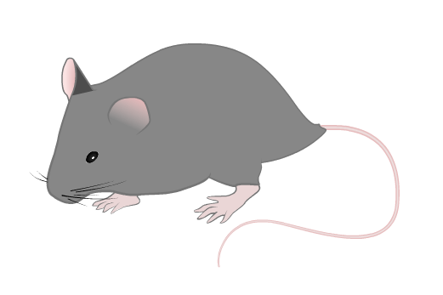
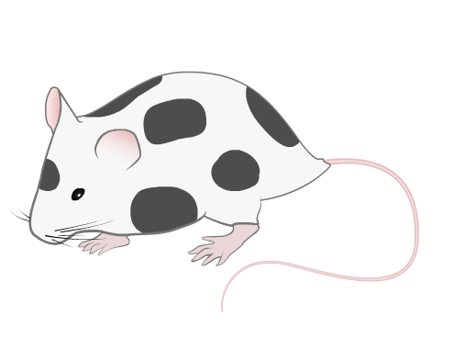
Genetics Vocabulary - Dominance
Phenotypes of heterozygous individuals can vary
Complete dominance – same as homozygous
Incomplete dominance – an intermediate
Codominance – both phenotypes shown
Notes:
Heterozygous individuals do not always look like the homozygous dominant genotype. The phenotype of heterozygous individuals depends on the type of dominance.
If the character displays complete dominance, heterozygous individuals look just like homozygous dominant individuals. For example, a heterozygous mouse have fur just as black as a homozygous mouse.
If the character displays incomplete dominance, heterozygous individuals will have a phenotype that is an intermediate between the two. In this case, a heterozygous mouse will have gray fur.
If the character displays codominance, heterozygous individuals will display both phenotypes independently. In this case, a heterozygous mouse will have spotted fur. In flowers that display codominance, the color might be striped. Blood type in humans also displays codominance. People with the allele for both A and B have the blood type AB.

Slide 9
Genetics Vocabulary - Genotype
Individuals can be homozygous for some characters and heterozygous for others
What determines an organism’s genotype?
hh
Rr
TT
Bb
ww
Ss
Notes:
Individuals can be homozygous for some characters and heterozygous for others.
Well, what determines an organism’s genotype? Remember that organisms receive their DNA from their parents during sexual reproduction.

Slide 10
Test Cross
A homozygous red-flowering plant is crossed with a homozygous white-flowering plant. What genotype will the offspring have?
RR
rr
Rr
Notes:
Let’s look at an example. Here, a homozygous red-flowering plant is crossed with a homozygous white-flowering plant. What will their offspring look like?
Since the plants are both homozygous, their genotypes can be written as two of the same letter. We’ll use R for red flower color and r for white flower color.
Each parent will randomly donate one of their alleles to their offspring. The red-flowering plant only has R alleles and the white-flowering plant only has r alleles. Therefore, offspring will always get one of each and will have the genotype Rr.

Slide 11
Test Cross
A homozygous red-flowering plant is crossed with a homozygous white-flowering plant. If red is dominant, what phenotype will the offspring have?
RR
rr
Rr
red flowers
Notes:
We know that the offspring will have the genotype Rr, but what will its phenotype be? The question says that red is dominant over white. This means that whenever there is at least one red allele (R), the offspring will produce red flowers. The phenotype, therefore, is red flowers.

Slide 12
Monohybrid Cross
Two heterozygous red-flowering plants are crossed. What genotypes could the offspring have?
Rr
Rr
R
r
R
RR
Rr
RR, Rr, rr
r
Rr
rr
Notes:
In the previous example, both parents were homozygous so they could only donate one allele. Since the parents in this example are heterozygous, they can donate one of two different alleles. Each parent will randomly donate one of their alleles to their offspring. We can organize the possibilities using a Punnett square.
First, draw a square with four compartments. Label the top with the two alleles one parent can donate. Label the left side with the two alleles the other parent can donate.
Next, complete each square by writing the allele on top and the allele to the left. If one is capitalized, write that first.
The genotypes possible are RR, Rr, and rr.
These boxes represent equal chances of offspring genotypes. It is just as likely for an organism to get the genotype in the top left box or the bottom right box. Notice one genotype, Rr, is found in two boxes.

Slide 13
Monohybrid Cross
Two heterozygous red-flowering plants are crossed. If red is dominant over white, what is the most likely phenotype in the offspring?
Rr
Rr
R
r
R
RR
Rr
Red
r
Rr
rr
Notes:
This question wants to know what phenotype is the most likely. To find this, we need to determine what phenotype each possible. The question says that red is dominant over white. This means that any offspring with the red allele (R) will have the trait red flowers. Only homozygous recessive offspring will have white flowers. Since three of the four boxes produce red flowers, this is the most likely phenotype.
Keep in mind that this is probability, not a guarantee. While not likely, it is possible that four offspring could be produced and all of them produce white flowers.

Slide 14
Monohybrid Cross
Two heterozygous red-flowering plants are crossed. If red is dominant over white, what are the average genotypic and phenotypic ratios?
Rr
Rr
R
r
Genotypes
R
RR
Rr
1 RR : 2 Rr : 1rr
Phenotypes
r
Rr
rr
3 red : 1 white
Notes:
This question is the same cross, but wants to know the genotypic and phenotypic ratios. Ratios are expressions of frequency. Since it is three times as likely for an offspring to have red flowers as compared to white flowers, we can say that the phenotypic ratio is 3 red : 1 white. Similarly, it is twice as likely for an offspring to have the genotype Rr than rr or RR. Therefore, the genotypic ratio is 1 RR : 2 Rr : 1 rr.

Slide 15
Monohybrid Cross
Two heterozygous red-flowering plants are crossed. If color is codominant, what is the most likely phenotype in the offspring?
Rr
Rr
R
r
R
RR
Rr
Pink
r
Rr
rr
Notes:
If color was codominant in these flowers, the heterozygous individuals would show both phenotypes at once, resulting in a pink appearance. Now the phenotypic ratio would be 1 red : 2 pink : 1 white. Pink would be the most likely phenotype.

Slide 16
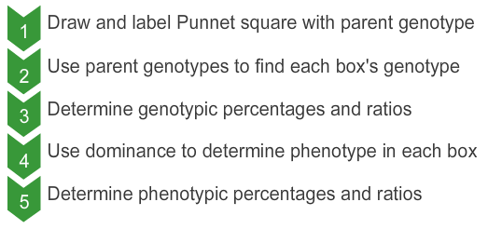
Using Punnett Squares
Any genetics problem can be worked using the five steps below

Slide 17
Dihybrid Crosses
Two heterozygous red-flowering and heterozygous tall plants are crossed. If both characters are completely dominant, what fraction of their offspring will be tall and red-flowering (on average)?
RT
Rt
rT
rt
R
T
RrTt x RrTt
RRTT
RRTt
RrTT
RrTt
R
t
9/16
RRTt
RRtt
RrTt
Rrtt
r
T
RrTT
RrTt
rrTt
rrTT
r
t
RrTt
Rrtt
rrTt
rrtt
Notes:
In this question, both parents are heterozygous for height and flower color. We can write this genotype as RrTt. What fraction of their offspring will be tall and red flowering? You can also use Punnett squares to analyze two characters at once. To solve these, use the same five steps from before.
First, draw a big enough Punnett square to fit all the different allele combinations. Before, each parent had two different alleles they could give. Now they have four, two from each character. Each parent will donate one allele from each character. Remember that offspring are made from one egg and one sperm cell. Therefore, the alleles will be given in pairs, such as RT or rT.
Second, fill each box with the genotype from the alleles above and to the left. Work one letter at a time. For example, the first box will inherit two R and two T to have the genotype RRTT.
This question is asking what fraction of the offspring will be tall and red-flowering (on average). Since both traits are completely dominant, this would be any box with both an R and an T. There are 9 of these boxes and 16 total boxes giving a fraction of 9/16.

Slide 18
Dihybrid Crosses
Two heterozygous red-flowering and heterozygous tall plants are crossed. If both characters are completely dominant, what are the average genotypic and phenotypic ratios?
RT
Rt
rT
rt
Phenotypic
Genotypic
R
T
9
3
3
1
RRTT
RRTt
RrTT
RrTt
RRTT
RRTt
RRtt
RrTT
RrTt
Rrtt
rrTT
rrTt
rrtt
1
2
1
2
4
2
1
2
1
red/tall
red/short
white/tall
white/short
R
t
RRTt
RRtt
RrTt
Rrtt
r
T
RrTT
RrTt
rrTt
rrTT
r
t
RrTt
Rrtt
rrTt
rrtt
Notes:
If the question wanted to know the phenotypic ratio, you would need to count each different phenotype. For example, there are three boxes with at least one R but only t allele so 3/16 will be red and short. Only one box has the genotype rrtt so only 1/16 will be white and short – completely unlike its parents.
The genotypic ratio can be found by counting each different genotype. Even though both parents had the same genotype, they can produce 9 different genotypes in their offspring. The most common genotype would be the same as theirs, but any other combination could still be seen.

Slide 19
Using Punnett Squares
Any genetics problem can be worked using the five steps below
Notes:
While a bigger box may be needed to draw out dihybrid crosses, all genetics problems can still be worked out using the same five steps.

Slide 20
Using Punnett Squares
Learning Objectives
Understand basic genetics vocabulary
Predict outcomes of monohybrid crosses
Predict outcomes of dihybrid crosses
B
b
B
BB
Bb
b
Bb
bb
Notes:
You should now feel comfortable with basic genetic vocabulary. You should also be able to predict outcomes of monohybrid and dihybrid crosses by using Punnett squares.

